Slide 1



Enterprise Document Intelligence
Dr. Doc
RAG-Powered Chatbot for Enterprise Document Intelligence
Deva Dharshan D
Employee ID: xxxxxx · Tata Technologies
Tata Technologies
September 25, 2026
01 / 17

Slide 2
Tata Technologies
02 / 17
The Problem
Every day, knowledge workers lose hours searching through documents — the cost is missed insights and delayed decisions.
Time Lost
Errors Made
Insights Missed
Hours Daily
Error-Prone
Knowledge Silos
Organizations manage vast volumes of PDFs, Word documents, and text files — finding a single answer demands searching across dozens of files manually.
Manual document review is inherently error-prone — critical details are missed, outdated versions are referenced, and conclusions are drawn from incomplete information.
Delayed decisions and knowledge silos prevent teams from leveraging the full intelligence embedded in their own document repositories.
Multiple formats: PDF, DOCX, TXT scattered across systems
Insights buried in documents never surface to decision-makers
Decisions made on stale or partially-read documents
No unified search — users read entire documents to find one fact
No audit trail linking answers back to source content
Cross-document patterns invisible without manual synthesis
Cross-document inconsistencies go undetected
Repeated effort across teams with no shared knowledge layer
Delayed decisions erode competitive advantage
Enterprise Document Challenge
Deva Dharshan D | 931033
September 25, 2026

Slide 3
Dr.Doc — The Solution
Dr.Doc eliminates document search friction by letting users ask questions in plain language and get grounded, cited answers instantly.
Locally Hosted RAG
Multi-Document Analysis
Voice Interaction
Image-Based Q&A
Architecture Flow
Azure OpenAI
User
Web UI
Flask Backend
GPT-4.1-mini
Embeddings
GPT-4 Vision
Whisper
FAISS
Natural language question
HTML / JS / Bootstrap
Python 3.13 · REST API
Chat
text-embed-3-large
Image Q&A
Speech-to-Text
Vector Store · Cosine Similarity
Tata Technologies | Deva Dharshan D · 931033
03 / 17

Slide 4
Feature Highlights
Six integrated capabilities make Dr.Doc a complete enterprise document intelligence platform.
Document Ingestion
Intelligent Q&A
Multi-Document Analysis
PDF, DOCX, and TXT files with drag-and-drop upload. Multi-file batch support with per-file progress tracking.
RAG-powered answers grounded in your documents. Conversation memory preserved across sessions.
Cross-document comparison and synthesis. Ask a single question across your entire knowledge base simultaneously.
Upload
RAG
Cross-Doc
Voice Input & Output
Image Q&A
Chat History
Speech-to-text via Web Speech API or Azure Whisper. Text-to-speech on every response with configurable voice and speed.
GPT-4 Vision analyzes uploaded images in real time. Interpret diagrams, charts, handwritten notes, and photographs.
Multiple sessions with rename and delete controls. Auto-pruned localStorage capped at 30 chats for consistent performance.
Multimodal
Vision
Sessions
Tata Technologies
04 / 17

Slide 5
Smart Document Processing Pipeline
Every uploaded document passes through a precise extraction and embedding pipeline that ensures high-quality, deduplicated vector retrieval.
1
2
3
4
5
6
Upload File
Text Extraction
Token-Based Chunking
Embedding Generation
FAISS Vector Index
Ready for Q&A
Drag-and-drop or browse; multiple files supported
PDF, DOCX, TXT parsing including tables
tiktoken cl100k_base — 400 tokens, 50-token overlap
text-embedding-3-large, 3072 dims via Azure OpenAI
Cosine similarity indexing for fast retrieval
Fully searchable knowledge base
SHA-256 Deduplication
Per-File Error Handling
Multi-File Batch Support
Normalized whitespace fingerprint prevents re-indexing identical content
Individual file failures do not abort batch processing
Multiple documents processed and indexed in a single upload session
Tata Technologies — Dr.Doc RAG Chatbot | Deva Dharshan D (931033)
05 / 17

Slide 6
Retrieval-Augmented Generation
RAG grounds every answer in actual document content — eliminating hallucination and providing transparent source attribution.
User Question
Embed Question
FAISS Search
Build Context
LLM Generates Answer
Display in Chat
Natural language input via chat interface
text-embedding-3-large
Cosine similarity across vector index
Chunks assembled from multiple documents as context window
GPT-4.1-mini produces response with citations
Answer rendered with source attribution in chat UI
3072-dim vector
Top 8 chunks
Azure OpenAI
Conversation Memory: Last 6 messages sent to LLM alongside retrieved context — enabling multi-turn, coherent dialogue across the session.
Dr.Doc — Intelligent Document Assistant | Deva Dharshan D (931033)
Tata Technologies | September 25, 2026

Slide 7
Cross-Document Analysis
Dr.Doc does not silo documents — it reasons across the entire knowledge base simultaneously, enabling synthesis no manual review could match.
Example Interaction
Compares, contrasts, and synthesizes information across all uploaded documents simultaneously
Dynamic sample prompts auto-generated from document vocabulary and detected topics
System prompt instructs the LLM to reference ALL documents in the knowledge base — not just the most similar
Instant cross-document intelligence — no switching between files or manual aggregation needed
User Query
"Compare the main ideas across all 3 documents"
Dr.Doc Response
Drawing from all indexed sources, here are the key themes and contrasts across your 3 documents...
Document 1
Document 2
Document 3
Response draws from every indexed source — no manual file switching required
Tata Technologies | Deva Dharshan D (931033) | September 25, 2026
07 / 17

Slide 8
Multimodal Input & Output
Dr.Doc meets users where they are — whether they type, speak, or listen, the interface adapts seamlessly.
INPUT MODE
OUTPUT MODE
Voice Input
Voice Output
Browser Web Speech API
Text-to-Speech on Every Message
Real-time transcription on Chrome & Edge — no extra setup required
Speaker icon on every assistant response — one click to listen
LIVE TRANSCRIPTION
Configurable Voice, Speed & Pitch
Azure Whisper Fallback
Adjust voice character, pitch, and playback speed
Seamless fallback for all other browsers via Azure OpenAI Whisper model
0.5x
1.0x
1.5x
2.0x
Microphone Button & Live Indicator
Auto-Speak & Live Preview
Visual recording indicator shows active capture state in real time
Hands-free mode auto-reads responses; live preview when adjusting voice settings
Dr.Doc — Intelligent Document Assistant | Tata Technologies
08 / 17

Slide 9
Slide 09 | Multimodal Capabilities
Visual Document Intelligence
When documents contain diagrams, charts, or handwritten notes, Dr.Doc's Vision capability reads them just like text.
Dr.Doc — Chat
How It Works
Upload Image in Chat
Users attach images directly in the chat interface — no separate upload flow
engineering_diagram.png
Image attached · Ready to analyze
GPT-4 Vision Analysis
What components are shown in this engineering diagram and how are they connected?
Azure OpenAI GPT-4 Vision performs real-time image understanding
Contextual Q&A
GPT-4 Vision
Images analyzed in conversation context — not stored in the RAG vector index
The diagram shows a hydraulic control system with three main components: pressure regulator , flow control valve , and actuator assembly . The regulator feeds into the valve via a high-pressure line (indicated by the bold arrows), and the valve modulates flow to the actuator. A feedback loop on the right returns pressure readings to the regulator for closed-loop control.
Use Cases
Engineering Diagrams
Handwritten Notes
Data Charts
Component Photos
Is this a closed-loop or open-loop system?
Images are analyzed in-context only — not persisted in the FAISS vector store, ensuring privacy and separation of concerns from document Q&A.
Based on the feedback arrow visible in the diagram, this is a closed-loop system . The actuator output is continuously monitored and fed back to adjust the pressure regulator.
Dr.Doc — Intelligent Document Assistant | Tata Technologies

Slide 10
Human-Computer Interaction Design
Every micro-interaction in Dr.Doc is designed to reduce cognitive load and keep the user focused on their document questions.
Dr.Doc — Intelligent Document Assistant
New Chat
Hello! I'm Dr.Doc
Recent
Ask me anything about your documents
Voice Input
Image Q&A
Multi-Doc
Compare BOM docs
Welcome Screen
Analyze spec v2
Compare docs
Summarize
Find clauses
Dr.Doc greeting with feature discovery pills — voice, image, multi-doc — surface capabilities at first glance
What are the key specs in the BOM?
Contract review
Typing Indicator
Policy Q&A
Based on your uploaded BOM, the key specifications include...
Animated bouncing dots signal the assistant is working — eliminating ambiguity while awaiting response
Copy
Edit
Re-ask
Read
diagram_v3.png — ready to send
Message Actions
Copy, Edit, Re-ask, Read Aloud on every assistant message — one-click access to power functions
Ask a question about your documents...
Sidebar
Chat history with New Chat, Rename, and Delete — full session management without leaving context
Image Preview Bar
Visual confirmation before sending — shows thumbnail and filename so users verify before submitting
Quick-Action Cards
Dynamic sample prompts auto-generated from document content — one-click starters to guide exploration
Tata Technologies
10 / 17

Slide 11
Technology Architecture
Tata Technologies
Modern Stack, Purposeful Choices
Dr.Doc | Internal
Dr.Doc is built on a carefully chosen modern stack — each layer selected for performance, cost-efficiency, and local data sovereignty.
Frontend
HTML5
CSS3
Vanilla JavaScript
Bootstrap Icons
Backend
Python 3.13
Flask
AI / ML
Azure OpenAI
GPT-4.1-mini (chat)
text-embedding-3-large
Whisper (speech)
GPT-4 Vision (image Q&A)
Vector Store
FAISS
Facebook AI Similarity Search
Cosine Similarity Indexing
Tokenizer
tiktoken
cl100k_base encoding
400-token chunks
50-token overlap
Speech APIs
Browser Web Speech API
SpeechSynthesis API
Storage
Filesystem (docs & embeddings)
localStorage (chat history)
Capped at 30 sessions
Tata Technologies | Deva Dharshan D (931033) | September 25, 2026
11 / 17

Slide 12
Robustness & Safety
Dr.Doc is designed to be enterprise-safe — data stays local, inputs are sanitized, and errors surface as friendly messages, not stack traces.
Enterprise Security & Reliability
XSS Prevention
API Error Handling
Auth & Connection Errors
All user inputs sanitized before rendering in chat — malicious scripts are neutralized at entry point.
Errors displayed as friendly chat messages — never raw stack traces or unformatted HTML in the UI.
Authentication and network errors identified and surfaced separately — users get clear, actionable context.
Global Error Handler
Data Locality
Human-in-the-Loop
JSON error handler applied uniformly to all Flask routes — consistent, parseable error responses every time.
Documents stored locally on-premise — zero cloud data leakage; full enterprise data sovereignty maintained.
System provides answers only — it never modifies, overwrites, or deletes source documents autonomously.
Tata Technologies
Dr.Doc — Intelligent Document Assistant | September 25, 2026

Slide 13
Engineering Quality
Targeted architectural improvements delivered measurable gains in accuracy, speed, and cost — without a full rewrite.
Improvement Area | Before | After
Conversation Memory | Stateless — no context | Last 6 messages sent to LLM
Token Chunking | Word-count based | Real token counting with tiktoken
Delete Performance | Re-embeds all documents | Slices stored embeddings — instant & free
Deduplication | MD5 on raw text | SHA-256 on normalized whitespace
Embedding Dimension | Hardcoded 3072 | Auto-detected from API response
DOCX Extraction | Paragraphs only | Paragraphs + tables
localStorage | Unbounded growth | Capped at 30 chats with auto-pruning
Tata Technologies | Dr.Doc — Intelligent Document Assistant | Deva Dharshan D (931033)
13 / 17

Slide 14
Live Demo Flow
Four steps, two documents, one image — the full Dr.Doc workflow in under three minutes.
1
2
3
4
Upload
Multi-Doc Query
Image Q&A
Voice Output
Add a PDF and a DOCX in the Feed tab
"Compare the main ideas across both documents"
Upload an image in chat, ask "What is this?"
Click the speaker icon to hear the response
Progress bar + success confirmation
Voice settings panel
Cross-document synthesized response
GPT-4 Vision response
Tata Technologies | Dr.Doc — Intelligent Document Assistant
14 / 17

Slide 15
Enterprise Applications
Where Dr.Doc Delivers Value
Any Tata Technologies business unit that works with documents can deploy Dr.Doc as an always-available knowledge assistant.
Engineering
Legal
HR
R&D
Quality
Analyze BOM data, CAD documentation, and design specifications across multiple files instantly.
Compare contract clauses across multiple agreements to surface inconsistencies and key terms.
Query policy documents and employee handbooks for instant, accurate answers without manual searching.
Cross-reference research papers and technical reports to accelerate discovery and synthesis.
Review audit reports and compliance documentation with natural language queries and citations.
Dr.Doc — Intelligent Document Assistant | Deva Dharshan D (931033)
15
Tata Technologies | September 25, 2026

Slide 16
Roadmap
What's Next
The production roadmap transforms Dr. Doc from a proof-of-concept into a scalable, multi-user enterprise platform.
Database Backend
Streaming Responses
Multi-User Support
Chunk Inspection UI
Rate Limiting & Cost
Export Reports
SQLite / PostgreSQL for production-grade persistence and structured session storage.
Server-Sent Events for real-time token streaming — faster perceived response time.
Authentication and role-based access control for secure team deployments.
Developer tool for debugging extraction quality and reviewing retrieved chunks.
API usage governance and cost visibility dashboard for enterprise management.
Download chat sessions as PDF or DOCX reports for documentation and sharing.
Phase 1
Phase 1
Phase 2
Phase 2
Phase 3
Phase 3
Tata Technologies | Dr.Doc — Intelligent Document Assistant
16 / 17

Slide 17
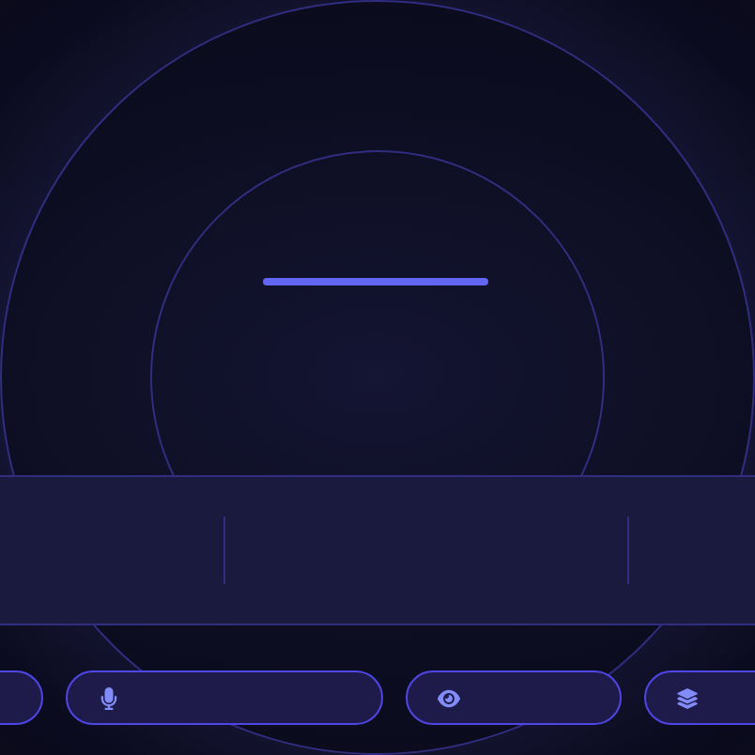
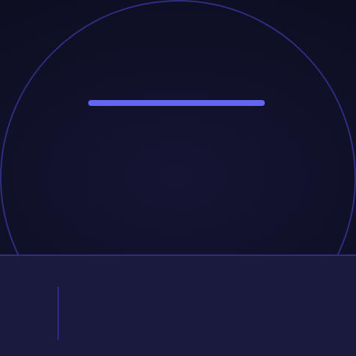
Thank You
Dr.Doc — Your Intelligent Document Assistant
Built with Azure OpenAI | Tata Technologies
Presented by
Employee ID
Organization
Contact
Deva Dharshan D
xxxxxx
Tata Technologies
xxxxxxxx.x@tatatechnologies.com
RAG-Powered Q&A
Voice Input & Output
Vision Q&A
Multi-Document Analysis
17 / 17

